Slide 1
NIST-MST Differential Privacy
Shubham Kaushal, Fred Cunningham, Daniel Young

Slide 2
Background

Slide 3
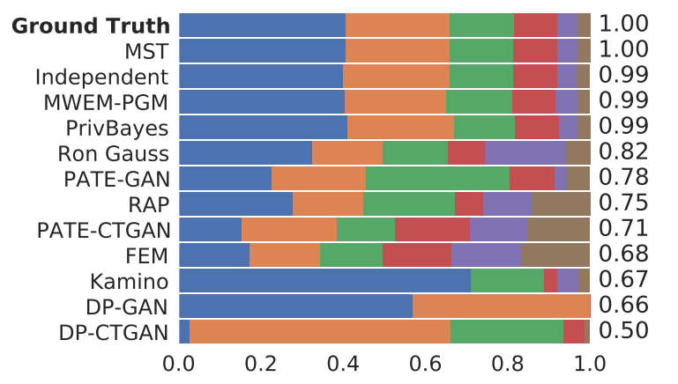
Differential Privacy: Motivation
Problem Statement:
Prevent reconstruction attacks on our dataset using the ε - differential privacy standard.
Solution:
NIST-MST chosen because survey paper¹ shows empirically that marginal based methods perform better than other methods such as GANs
1:https://aaai-ppai22.github.io/files/26.pdf

Slide 4
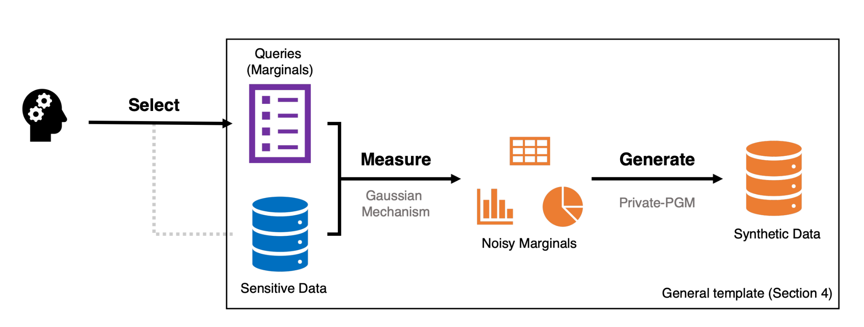
DP Approach: NIST-MST (Mckenna, Miklau, Sheldon)¹
Query Selection
Gaussian Mechanism
Private-PGM
1: https://arxiv.org/pdf/2108.04978.pdf

Slide 5
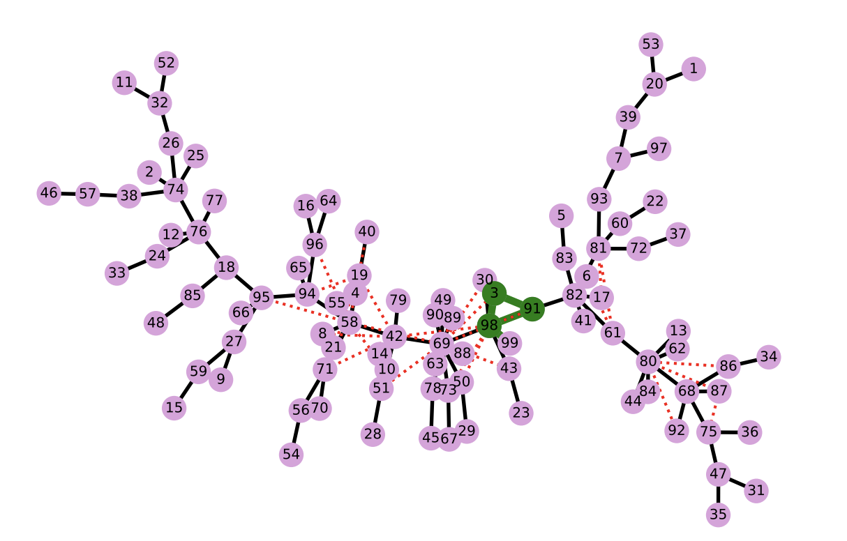
Query Selection: Preserve attribute dependence
Construct a graph of attributes with edges representing mutual information
Find a maximum spanning tree
Pick triplets with highest total correlation to preserve relationships

Slide 6
Measurement Noise: obscure underlying data
Given 2-3 way marginal distributions from query selection and remaining attributes as 1 way marginal distributions (independence assumption)
Measure estimated marginals with gaussian noise
Noise adjusted based on epsilon: larger epsilon -> smaller variance

Slide 7
Private-PGM: Re-Model underlying Distribution
Using the re-sampled marginal distributions construct a probabilistic graphical model
Sample a new dataset from the PGM that satisfies epsilon-DP

Slide 8
Exploration

Slide 9
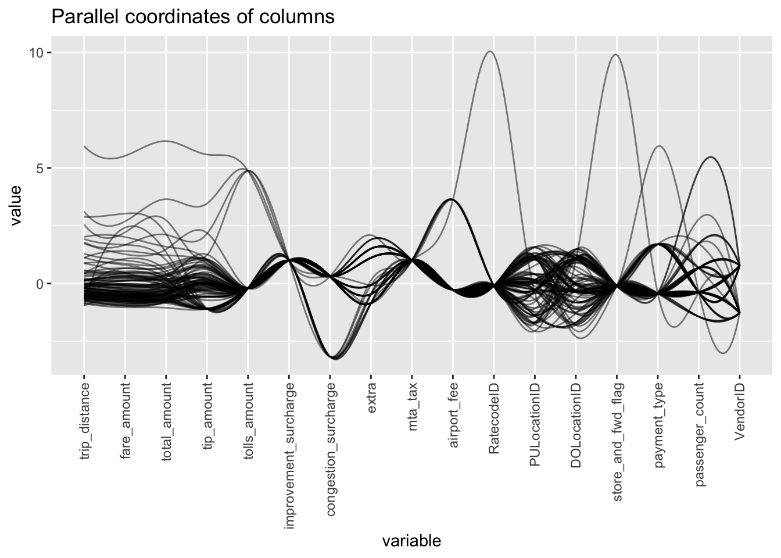
Taxi Dataset Visualization

Slide 10
Idea: Remove Too Highly correlated features
The model is too good!
Drop: total amount, fare amount, trip distance
(as well as other useless/unwieldy features like date/time)

Slide 11
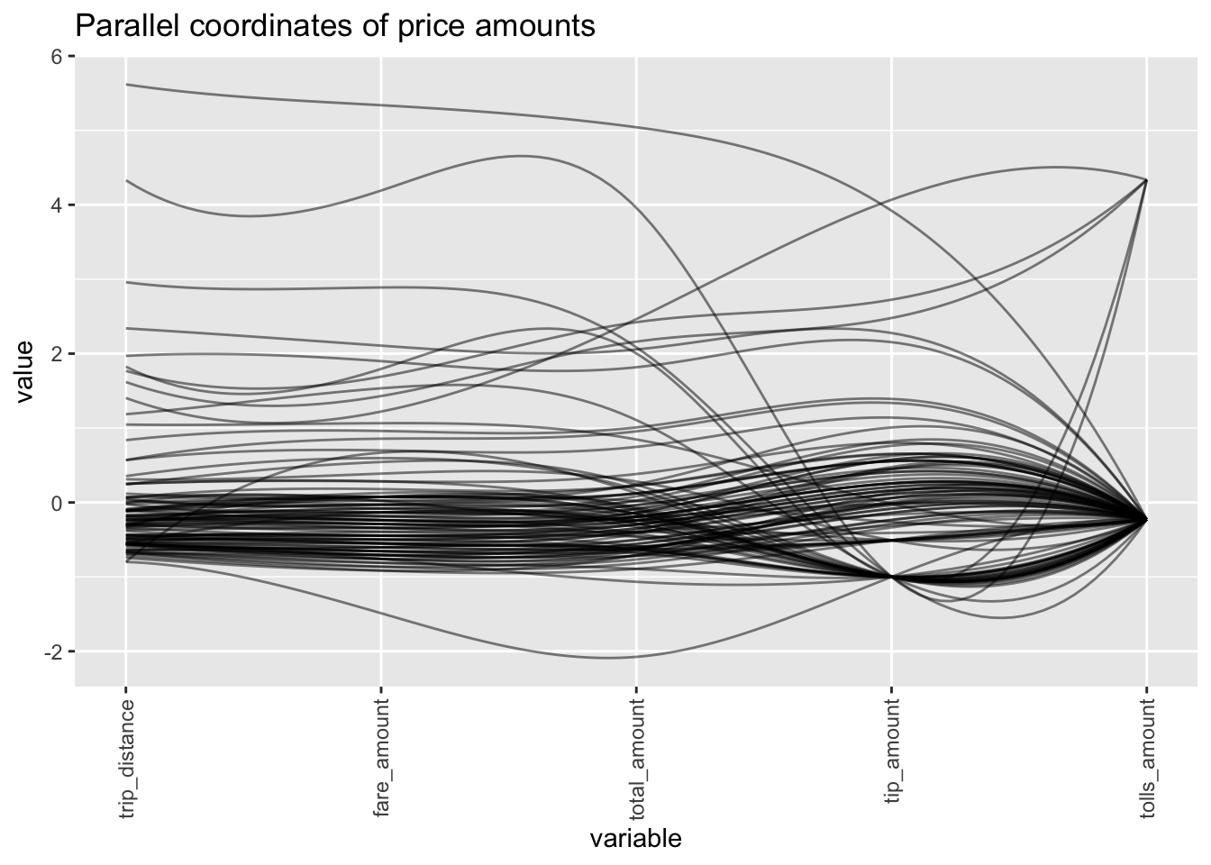
Show correlation

Slide 12
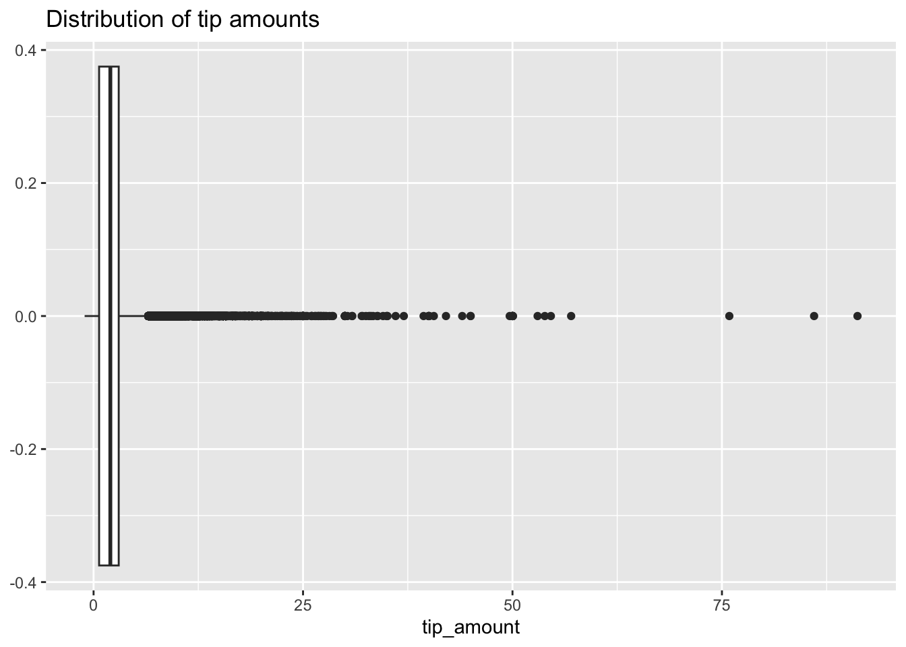
Distribution of Label

Slide 13
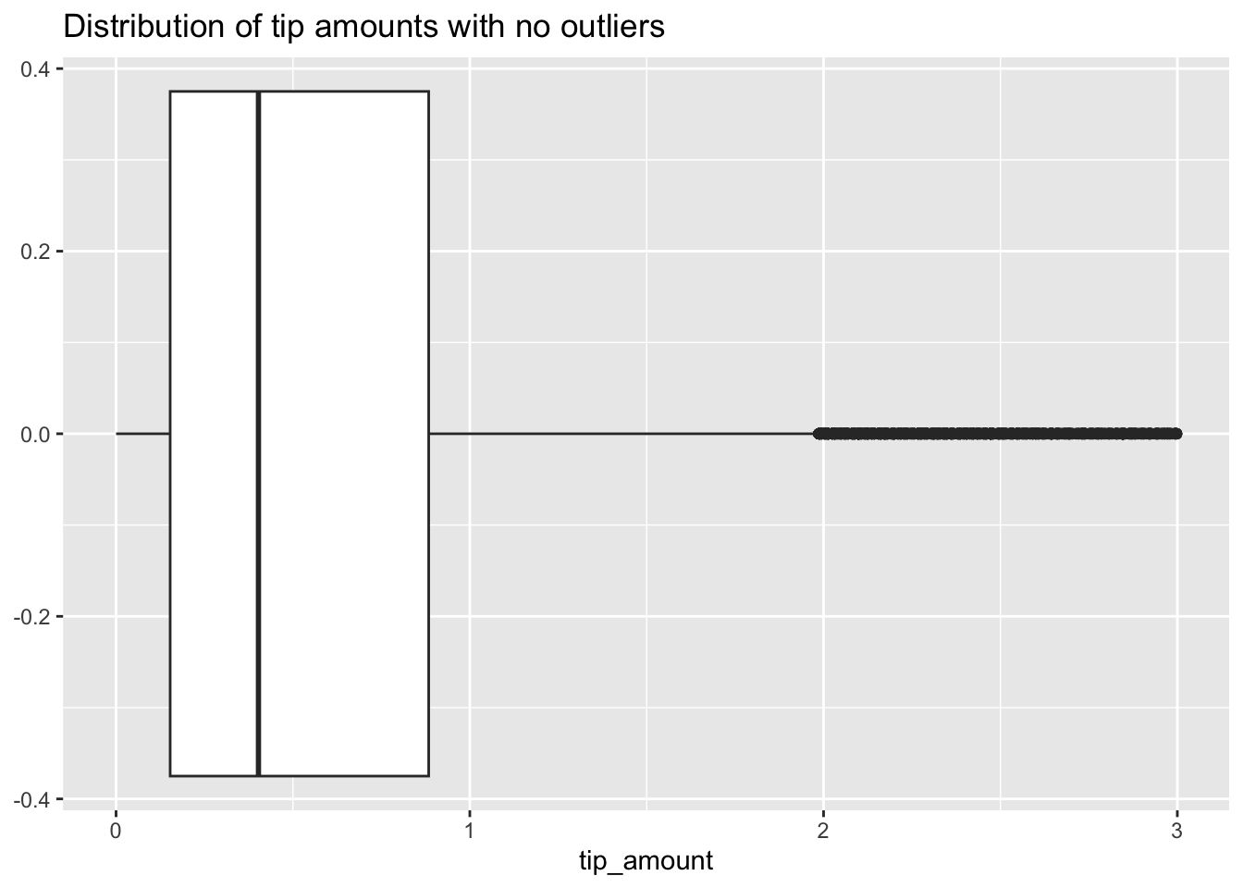
Remove Outliers

Slide 14
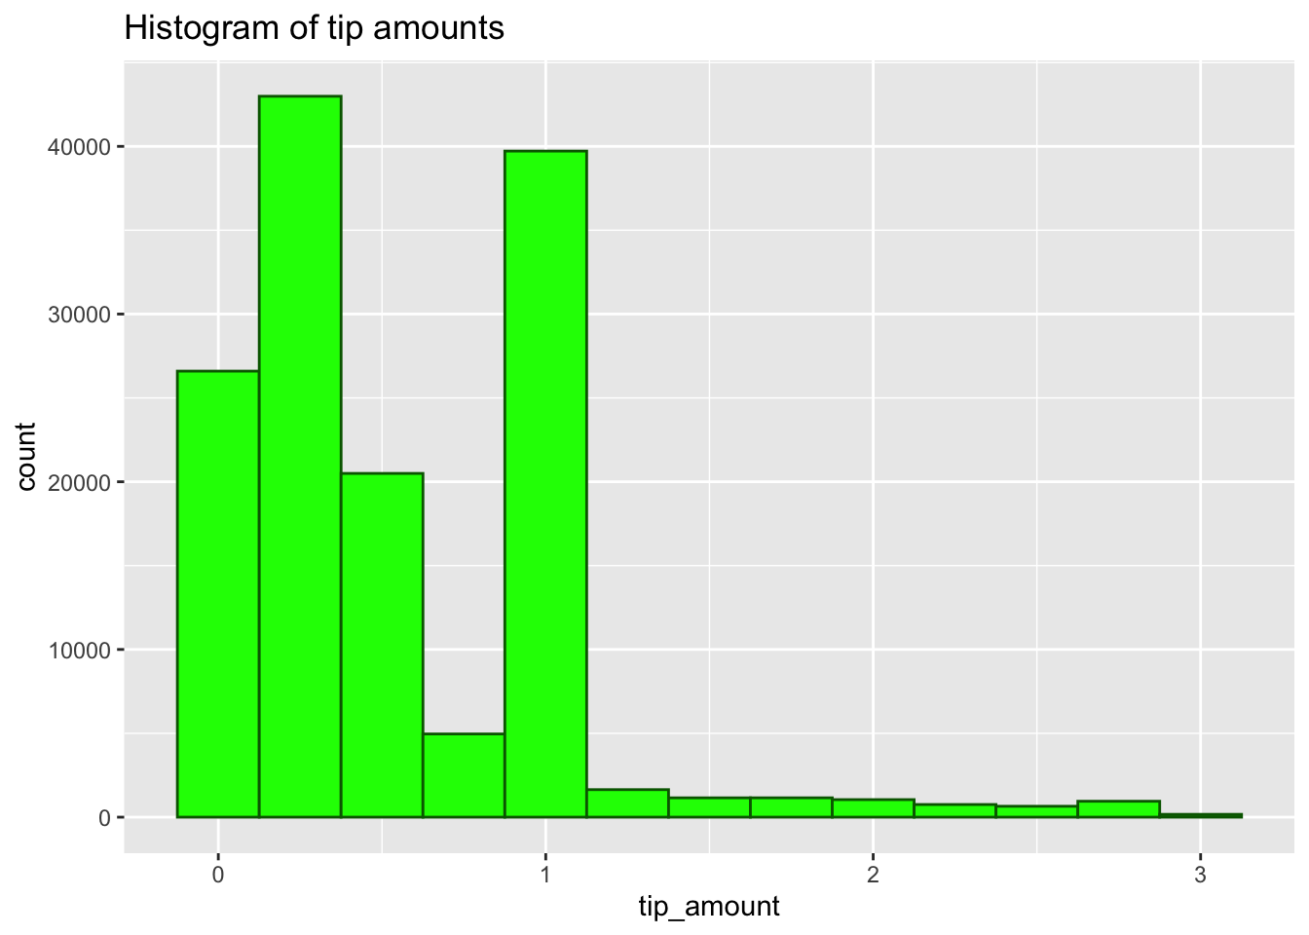
Histogram of Label

Slide 15
Methodology

Slide 16
Method
Perform train-test split with 80-20 ratio.
Discretize data because MST only works with categorical data
Then use MST to create discretized synthetic data by setting needed epsilon value (we tried 0, .1, .5, 1 & 2)
Finally, un-discretize synthetic data to create synthetic data in original format
Train on synthetic/original and test on original

Slide 17
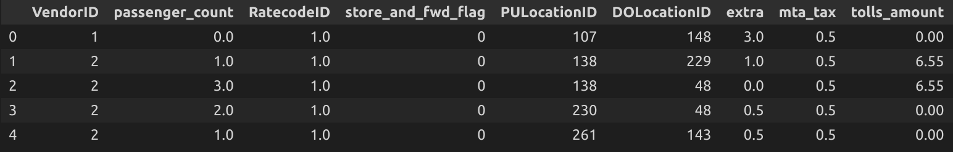
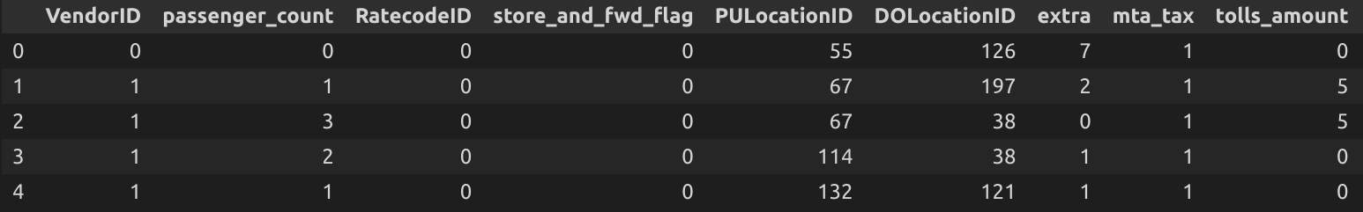
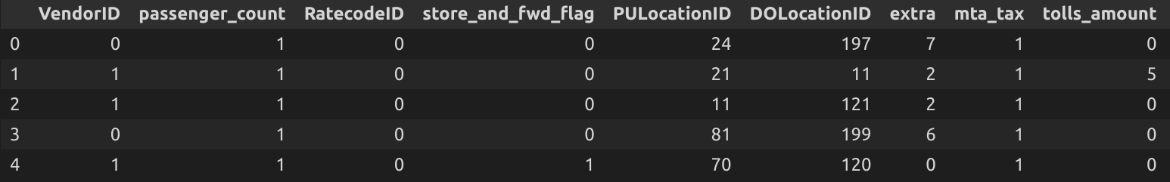
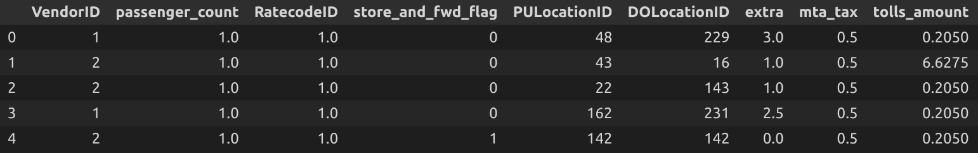

Slide 18
Results

Slide 19
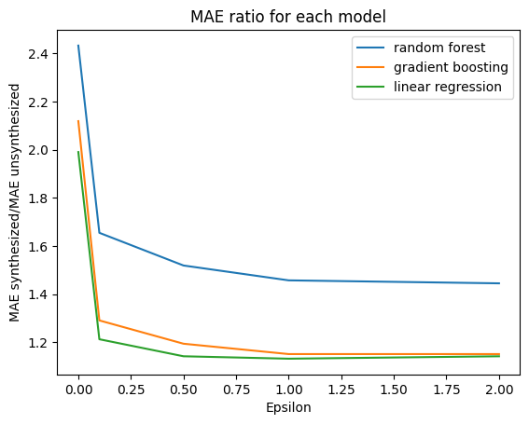
Results

Slide 20
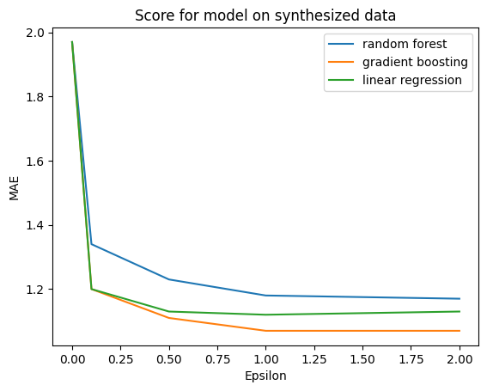
Final score

Slide 21
Results
Compare MAE synthetic / MAE original
Baseline: 1.97 MAE with synthetic epsilon = 0
As expected: as epsilon goes up (privacy goes down), error goes down
Accuracy ratio performance:
Linear regression > gradient boosting > random forest
Overall performance:
Gradient boosting > Linear regression > random forest

Slide 22
Correlation Matrix Comparison
Compare the information preserved in the synthetic data
Should maintain more inter-variable relationships with higher epsilon

Slide 23
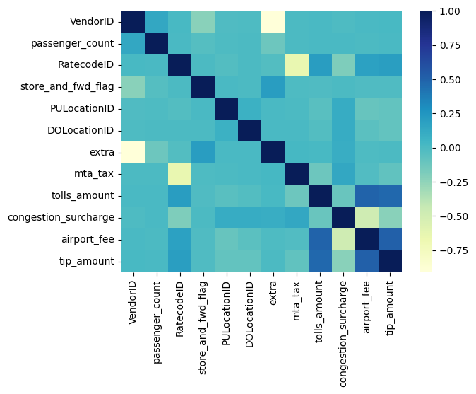
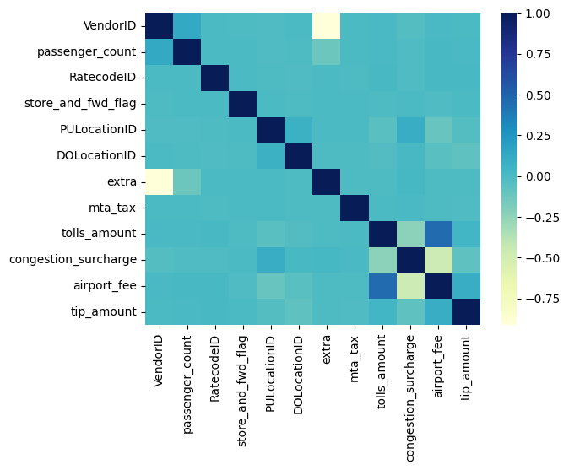
Epsilon = 1

Slide 24
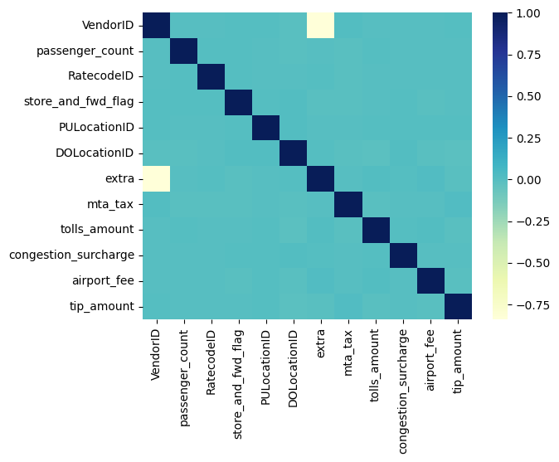
Epsilon = 0.1

Slide 25
Conclusion
Accuracy numbers not the best but idea behind project solid and trends support future potential
Are able to maintain trends in synthesized dataset with medium values of epsilon mathematically ensuring medium degree of privacy

Slide 26
Future Steps
Fine-tune models
Try more values of epsilon
Try method on different datasets
Deal with continuous in more fine-tuned way
Demonstrate performance with simulated reconstruction attack

